Slide 1
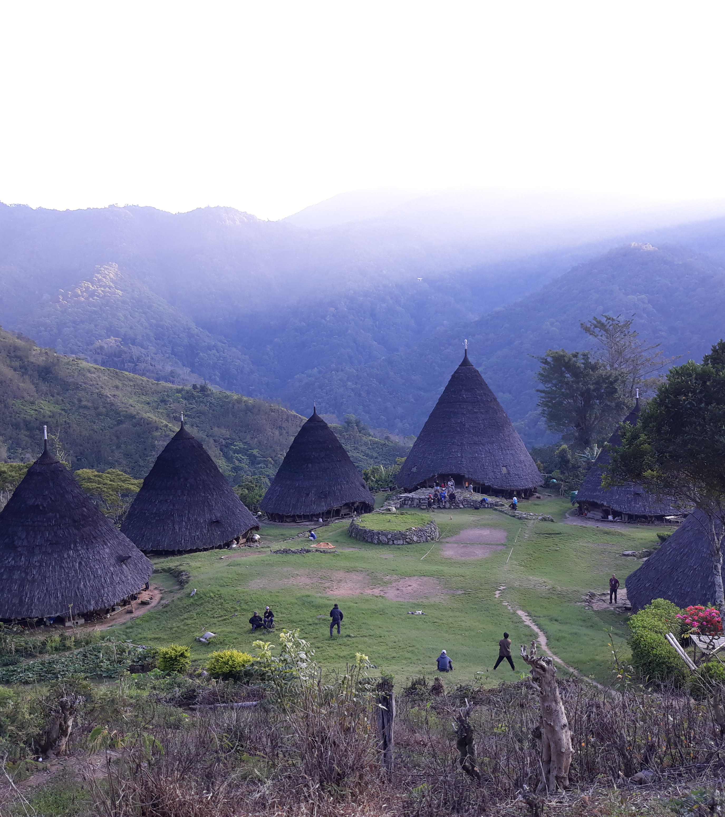
Travel Recommendation System
Chandira Irina

Slide 2

Project Outline
Main Issue
Background
Data
Data Retrieval
Data Cleaning
Model
Problem
Goal
Data Analytics and Visualization
Feature Engineering

Slide 3


MAIN ISSUE
BACKGROUND
82% of millennials travelled last year, compared with 75% of all other generations
(Source: https://www.condorferries.co.uk/millennials-travel-statistics-trends)
PROBLEM
2 in 3 millennials are interested in a service that provides surprise holiday recommendations based first on their personality, and second on their budget.
(Source: https://www.siteminder.com/r/trends-advice/hotel-travel-industry-trends/millennials-travel-20-interesting-stats-millennial-hotel-guests/)
GOAL
Build a recommendation system based on activities that is well known in a travel destination and show the approximate budget for each recommended destination, hence increasing the conversion into bookings.

Slide 4

DATA: Data Retrieval
Dataset was retrieved from Trip Advisor website by scraping.
Scraping list of travel destination in Indonesia
Scraping list of things to do in each of the retrieved travel destinations
Scraping spots in each of the travel destinations
Scraping hotel and flight data for each of the travel destinations (note: flight data was retrieved for Jakarta – destination roundtrip)

Slide 5
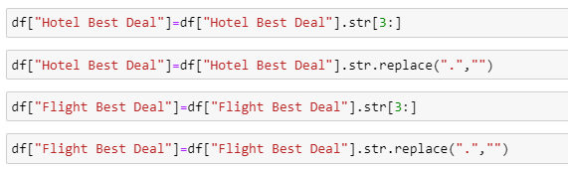
DATA: Data Manipulation
Formatting the data into the useful formatting, one of which by taking only the numbers out of the Hotel and Flight Price Data

Slide 6
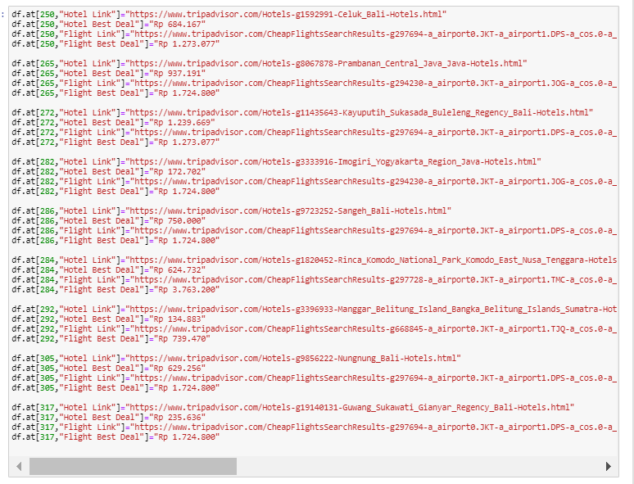
DATA: Handling Missing Data - 1
Filing up Nan values manually by checking back to the original data source (Trip Advisor website) →Merging_Indo-Copy 1

Slide 7
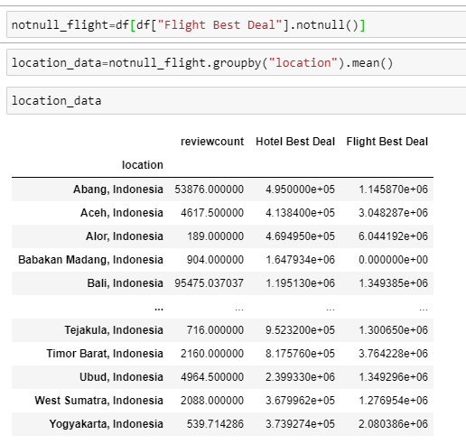
DATA: Handling Missing Data - 2
Filling up NaN values using mean values of the similar region → Merging_Indo – Copy 1

Slide 8
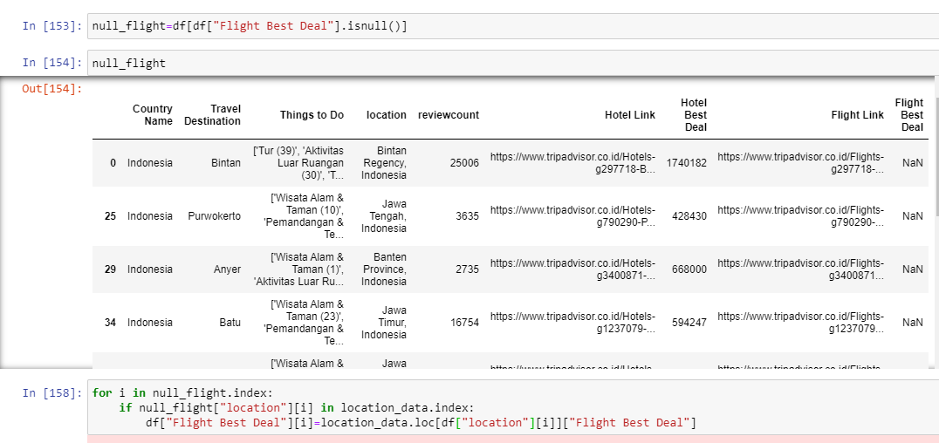
DATA: Handling Missing Data - 3

Slide 9
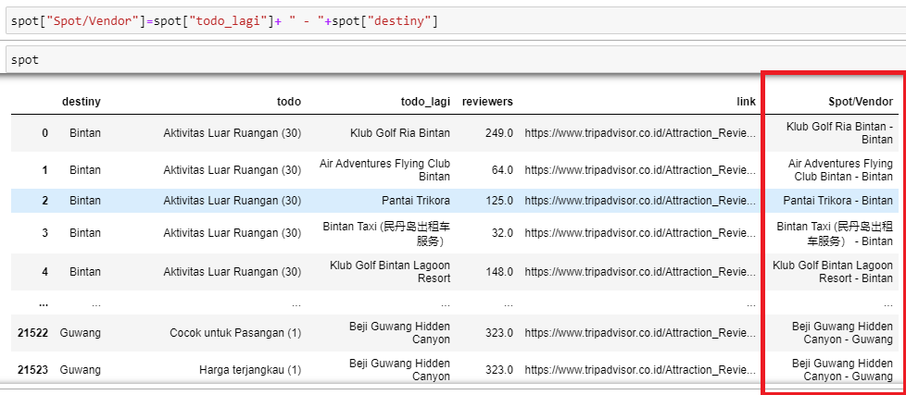
DATA: Feature Engineering - 1
Make a new column which is the aggregate of several other available data columns (in this case, combining two string-type columns to return Vendors name with its location)

Slide 10
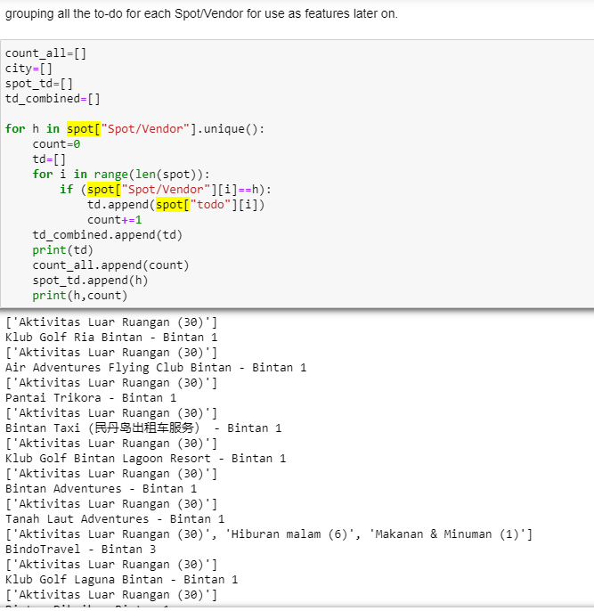

DATA: Feature Engineering - 2

Slide 11
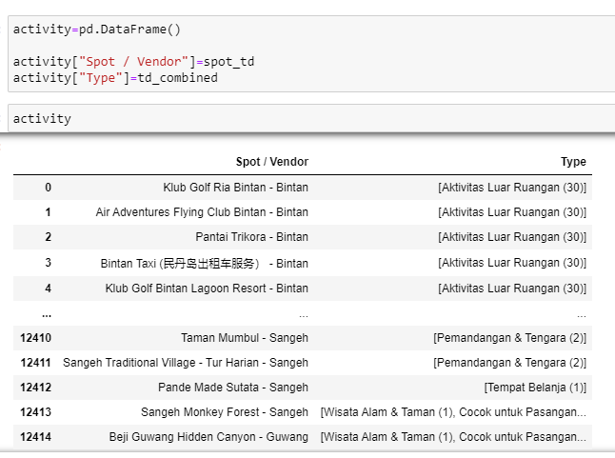
DATA: Feature Engineering - 3

Slide 12
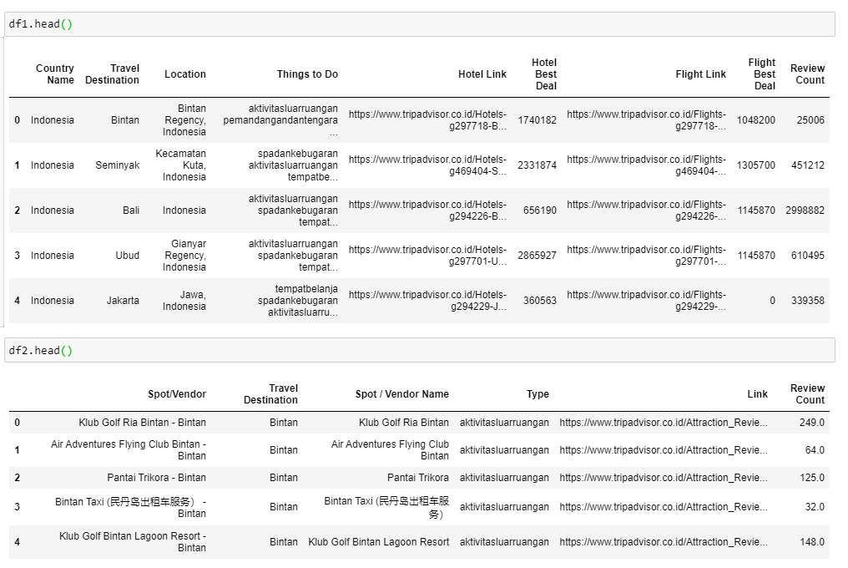
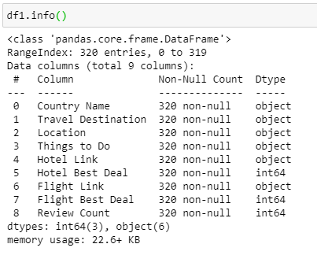
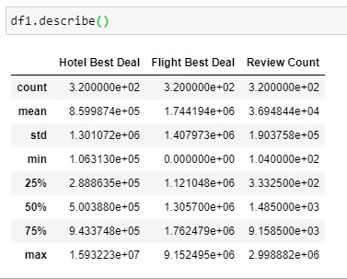
DATA: Final Dataset - 1

Slide 13
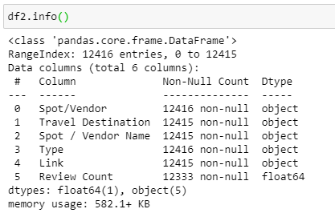
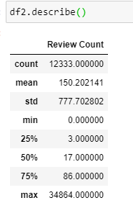
DATA: Final Dataset - 2

Slide 14
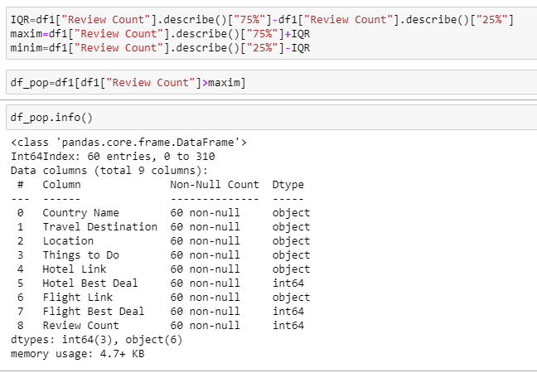
DATA: Data Analytics and Visualizations - 1
Analyzing the popularity distribution of destinations in Indonesia.

Slide 15
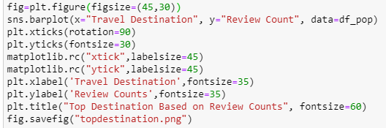
DATA: Data Analytics and Visualizations - 2
Out of the popular destinations, we plot the review counts.

Slide 16
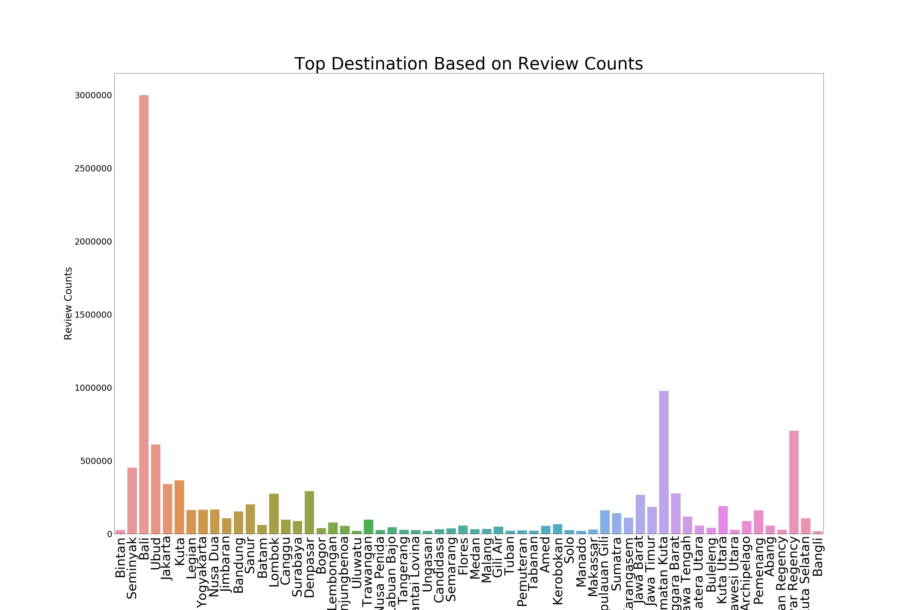
DATA: Data Analytics and Visualizations - 3

Slide 17
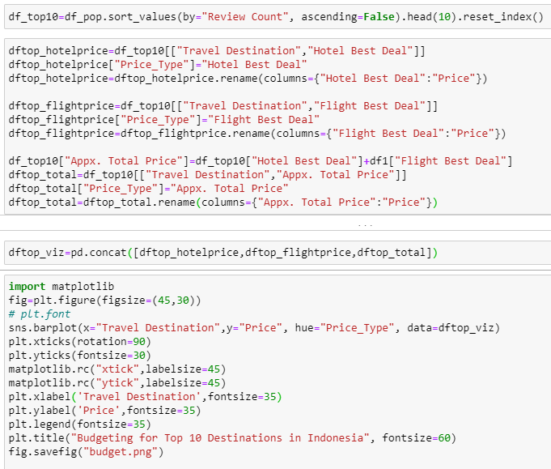
DATA: Data Analytics and Visualizations - 4
Out of the top 10 destinations, we also plot the approximate budgeting for traveler from Jakarta.

Slide 18
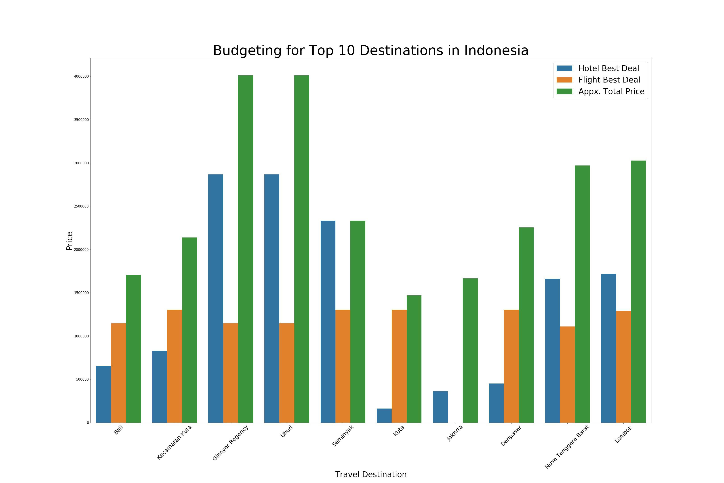
DATA: Data Analytics and Visualizations - 5

Slide 19

MODEL
Content-based recommendation system
Algorithm:
- cosine similarity
- Pearson correlation

Slide 20

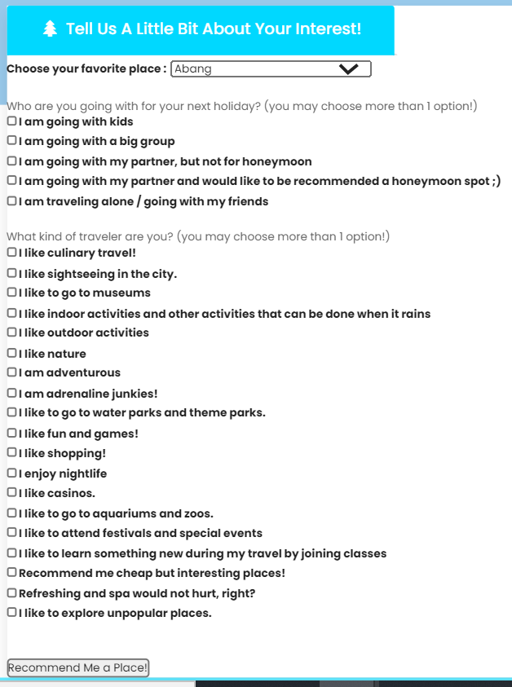
User input page

Slide 21
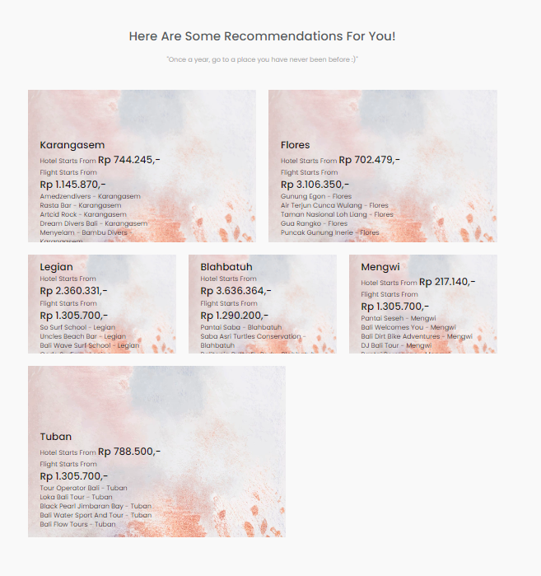
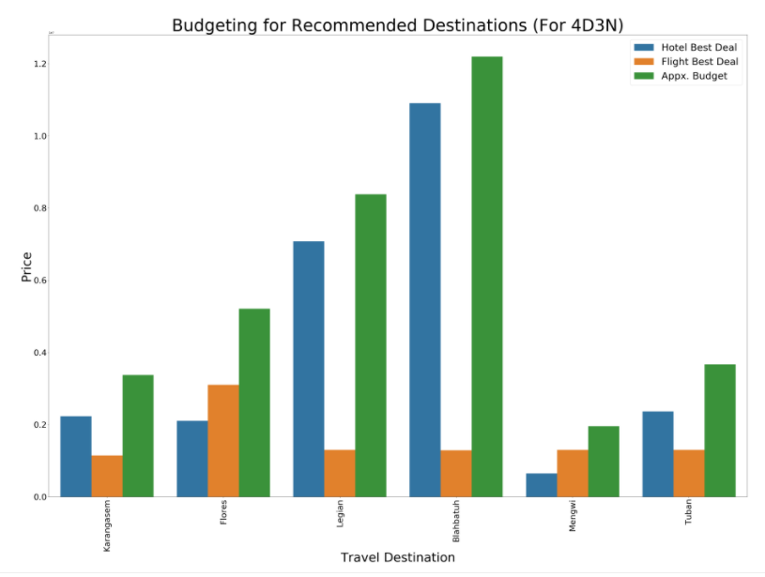
Recommendation page

Slide 22
CONCLUSION
it is very important to understand domain knowledge in the process of data analysis in order to handle the missing data and choose the suitable features for modeling.
evaluatioin in recommendation system is online evaluation, which means the model needs to go online first before we can judge its usefulness.
Upon online evaluation, we can compare with other similarity measures for further evaluation.
The current system can be enhanced by getting more information regarding the activities available in each destinations and spots.
Adding more features into the model may also be useful, such as hotel and flight preferences.

